Slide 1

Slides based on those by Paul Cairns, York (http://www-users.cs.york.ac.uk/~pcairns/) + ID3 book slides + slides from: courses.ischool.berkeley.edu/i213/s08/lectures/i213-14.ppt

Slide 2
Predictive models
Provide a way of evaluating products or designs without directly involving users.
Less expensive than user testing.
Usefulness limited to systems with predictable tasks - e.g., telephone answering systems, mobiles, cell phones, etc.
Based on expert error-free behavior.
www.id-book.com

Slide 3
GOMS
Goals – what the user wants to achieve eg. find a website.
Operators - the cognitive processes & physical actions needed to attain goals, eg. decide which search engine to use.
Methods - the procedures to accomplish the goals, eg. drag mouse over field, type in keywords, press the go button.
Selection rules - decide which method to select when there is more than one.
www.id-book.com

Slide 4
Keystroke level model
GOMS has also been developed to provide a quantitative model - the keystroke level model.
The keystroke model allows predictions to be made about how long it takes an expert user to perform a task.
www.id-book.com

Slide 5
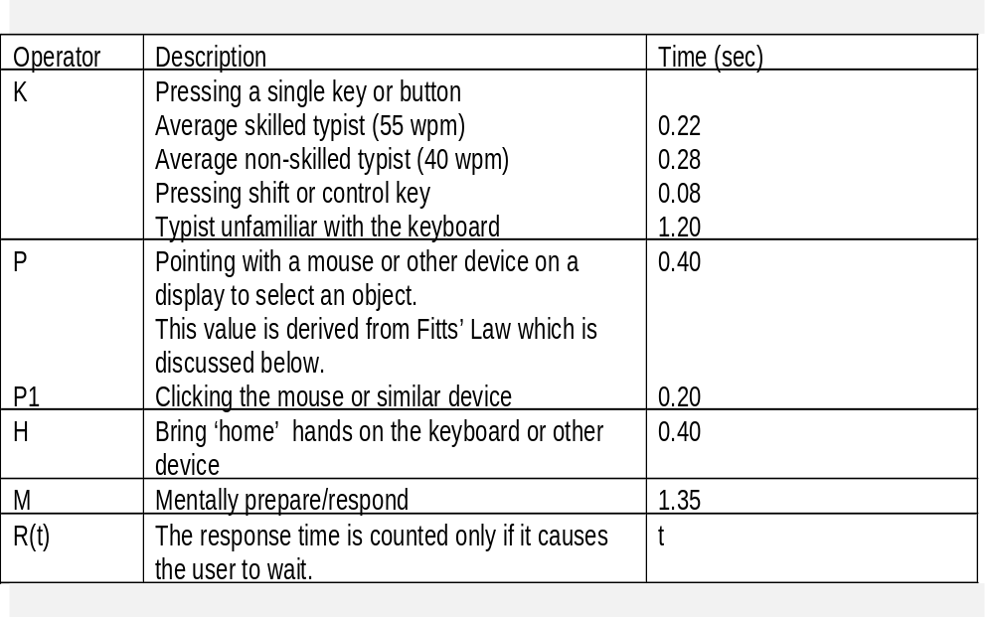
Response times for keystroke level operators (Card et al., 1983)
www.id-book.com

Slide 6
Summing together
www.id-book.com

Slide 7
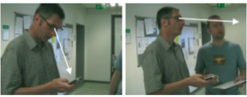
Using KLM to calculate time to change gaze (Holleis et al., 2007)
Had to add new operators (e.g., Macro Attention shift)
www.id-book.com

Slide 8
Fitts’ Law (Fitts, 1954)
Fitts’ Law predicts that the time to point at an object using a device is a function of the distance from the target object & the object’s size.
The further away & the smaller the object, the longer the time to locate it & point to it.
Fitts’ Law is useful for evaluating systems for which the time to locate an object is important, e.g., a cell phone,
a handheld devices.
www.id-book.com

Slide 9
Fitts’ Law
Models movement time for selection
Movement time for a rehearsed task
  Increases with distance to target (d)
  Decreases with width of target (s)
  Depends only on relative precision (d/s), assuming target is within arms reach
First demonstrated for tapping with finger (Fitts 1954), later extrapolated to mouse and other input devices
Adapted from Hearst, Newstetter, Martin

Slide 10
Fitts’ Law Equation
T_{msec}= a + b log₂ (d/s + 1)
a, b = empirically-derived constants
d = distance, s = width of target
ID (Index of Difficulty) = log₂ (d/s + 1)
d
s
Adapted from Robert Miller

Slide 11
A Fitts’ law demo
Interactive Fitts' Law talk
RMH: Fitts' Law

Slide 12
Fitts’ Law Intuition
Time depends on relative precision (d/s)
Time is not limited by motor activity of moving your arm / hand, but rather by the cognitive activity of keeping on track
Below, time will be the same because the ratio d/s is the same
Target 1
Target 2

Slide 13
Fitts’ Law Examples
Target 1
Target 2
Target 1
Target 2
Adapted from Hearst, Irani

Slide 14
Determining a,b Constants
Conduct experiments varying d,s but keeping everything else the same
Measure execution time, error rate, accuracy
Exclude erroneous data
Perform linear regression
Adapted from Hearst, Irani

Slide 15
Exercise…Fitts’ Law
Visit Tog’s website and do Tog’s quiz, designed to give you fitts!
http://www.asktog.com/columns/022DesignedToGiveFitts.html
www.id-book.com

Slide 16
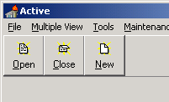
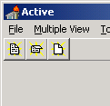
Fitts in Practice
Microsoft Toolbars allow you to either keep or remove the labels under Toolbar buttons
According to Fitts’ Law, which is more efficient?
Source: http://www.asktog.com/columns/022DesignedToGiveFitts.html
Adapted from Hearst, Irani

Slide 17

Fitts in Practice
You have a toolbar with 16 icons, each with dimensions of 16x16
Without moving the array from the left edge of the screen, or changing the size of the icons, how can you make this more efficient?
Adapted from Hearst, Irani

Slide 18
Fitts in Practice
Answer: Line up all 16 icons on the left hand edge of the screen
Make sure that each button can be activated up the last pixel on the left hand edge
Why? Because you cannot move your mouse off of the screen, the effective width s is infinite
Adapted from Hearst, Irani

Slide 19
Impact in HCI
Reduce ID
  Bigger icons, more space
Compare IP
  “Capacity” of input devices
Put things in edges and corners
RMH: Fitts' Law

Slide 20
Deconstructing Fitts
Ecological validity
Construct validity
RMH: Fitts' Law

Slide 21
What Fitts did:
W
D
RMH: Fitts' Law

Slide 22
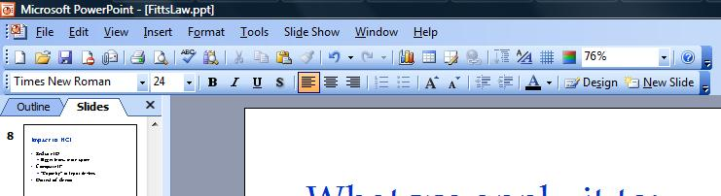
What we apply it to:
RMH: Fitts' Law

Slide 23
Correcting for W
W’ – actual cross-section
Smaller of W and H
Area, W x H
Sum, W + H
Stick with W
Which is best?
RMH: Fitts' Law

Slide 24

Toolbars
Annoying or useful?
Edges and corners?
RMH: Fitts' Law

Slide 25
Novel interactions
Artificially increasing W
  “Sticky” buttons
  Bubbles
Changing select
  Goal-crossing
RMH: Fitts' Law

Slide 26
Advanced Fitts’ Law
Fitts’ law as a model
Steering law
  Games
  Menu navigation
  VE/VR?
RMH: Fitts' Law

Slide 27
Steering Law
Applies same principles to steering through a tunnel (Accot, Zhai 1997)
Must keep the pointer within the boundaries throughout, not only at the target
In KLM, Fitts’ Law used for pointing, Steering Law used for drawing
D
S

Slide 28
Steering Law Equation
T_{msec}= a + b (d/s)
a, b = empirically-derived constants
d = distance, s = width of tunnel
ID (Index of Difficulty) = (d/s)
Index of Difficulty now linear, not logarithmic
(i.e. steering is more difficult then pointing)
D
S
Adapted from Robert Miller

Slide 29
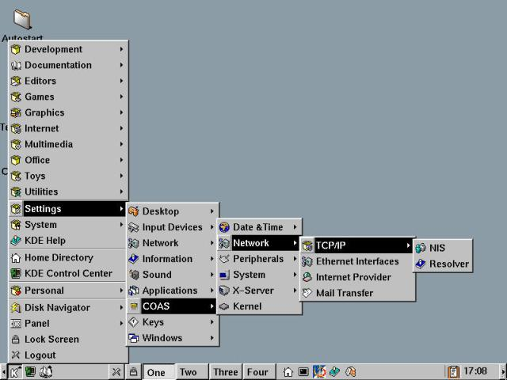
Source: http://linuxbook.orbdesigns.com/ch09/btlb_c09.html

